Slide 1
Large data visualization
Aleksandra Warchoł
Karolina Maruszak
Piotr Wodecki

Slide 2
TRIMAP: LARGE-SCALE DIMENSIONALITY REDUCTION USING TRIPLETS Ehsan Amid & Manfred K. Warmuth
Theoretical analysis
Verification of computational times
Comparison with t-SNE, LargeVis, UMap

Slide 3
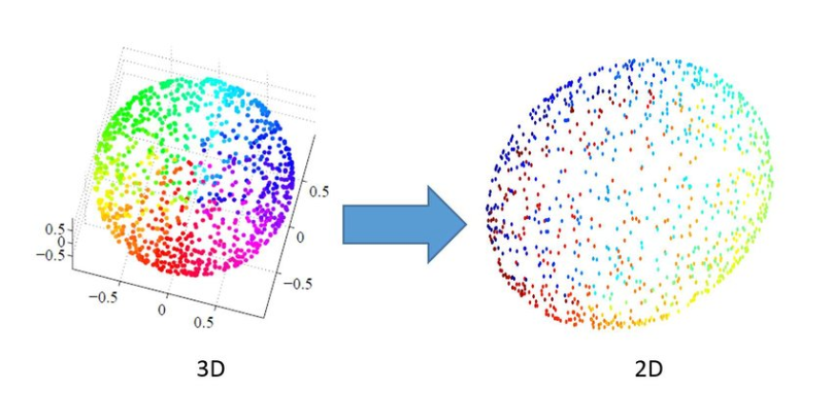
Dimensionality Reduction

Slide 4
The aim of DR is to provide a low-dimensional representation (typically in 2D or 3D) of a given high-dimensional dataset that preserves the overall structure of the data as much as possible

Slide 5
PCA
TriMap
t-SNE
LargeVis
UMap

Slide 6
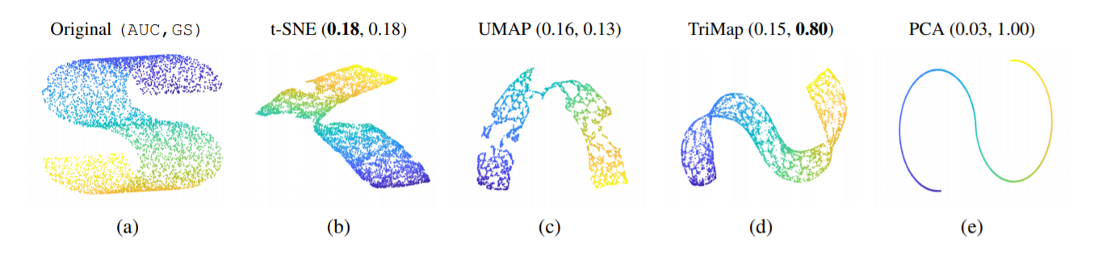
Example

Slide 7
What is TriMap?
Dimensionality reduction method
Uses triplet constraints to form a low-dimensional embedding
Provides a significantly better global view of the data than the other dimensionality reduction methods such t-SNE, LargeVis, and UMAP

Slide 8
(i, j, k) ⬄ point i is closer to point j than point k.

Slide 9
In many cases TriMap outperforms all the competitor non-linear methods by means of global score and provides comparable local accuracy.

Slide 10
Formal approach
We will now formally introduce the TriMap method

Slide 11
Find a set of triplets T := {(i, j, k)} so that Distance(i,j) < Distance(i,k)
Assign a weight w_{ijk} ≥ 0 for each triplet

Slide 12
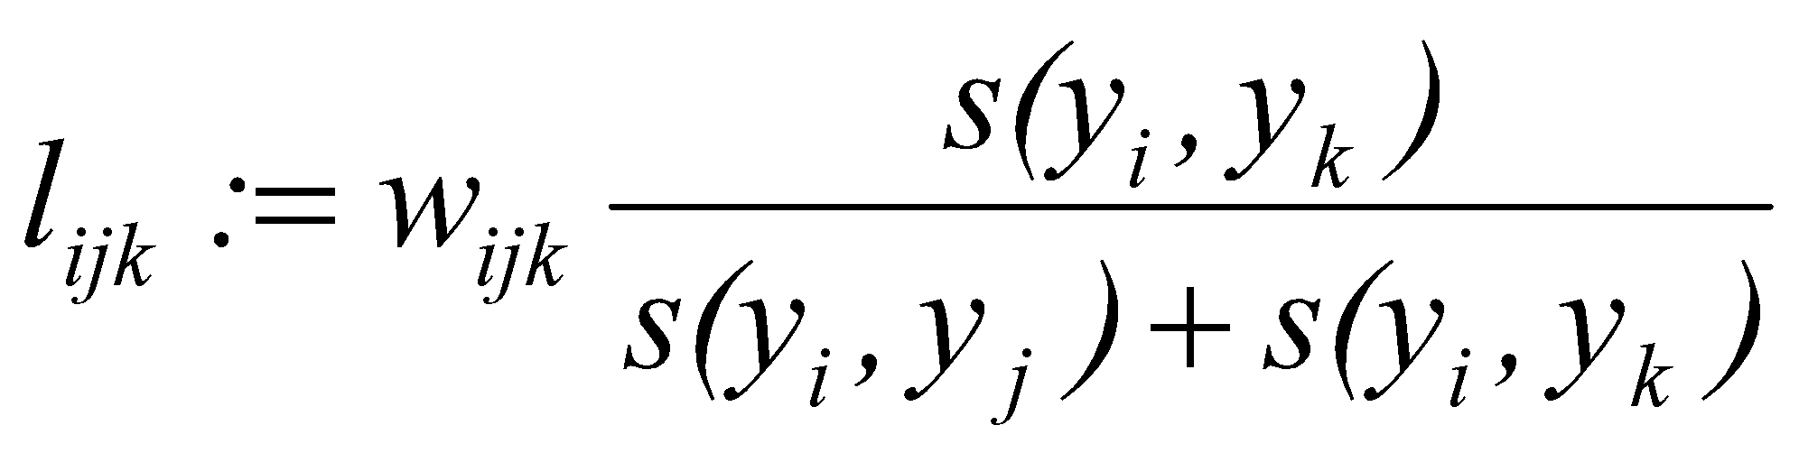
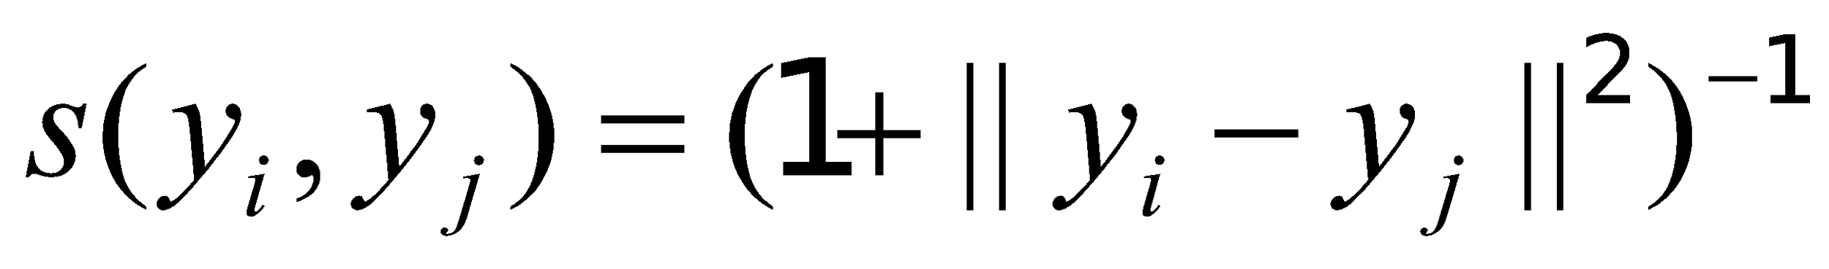
Define the loss of the triplet (i, j, k) as:

Slide 13

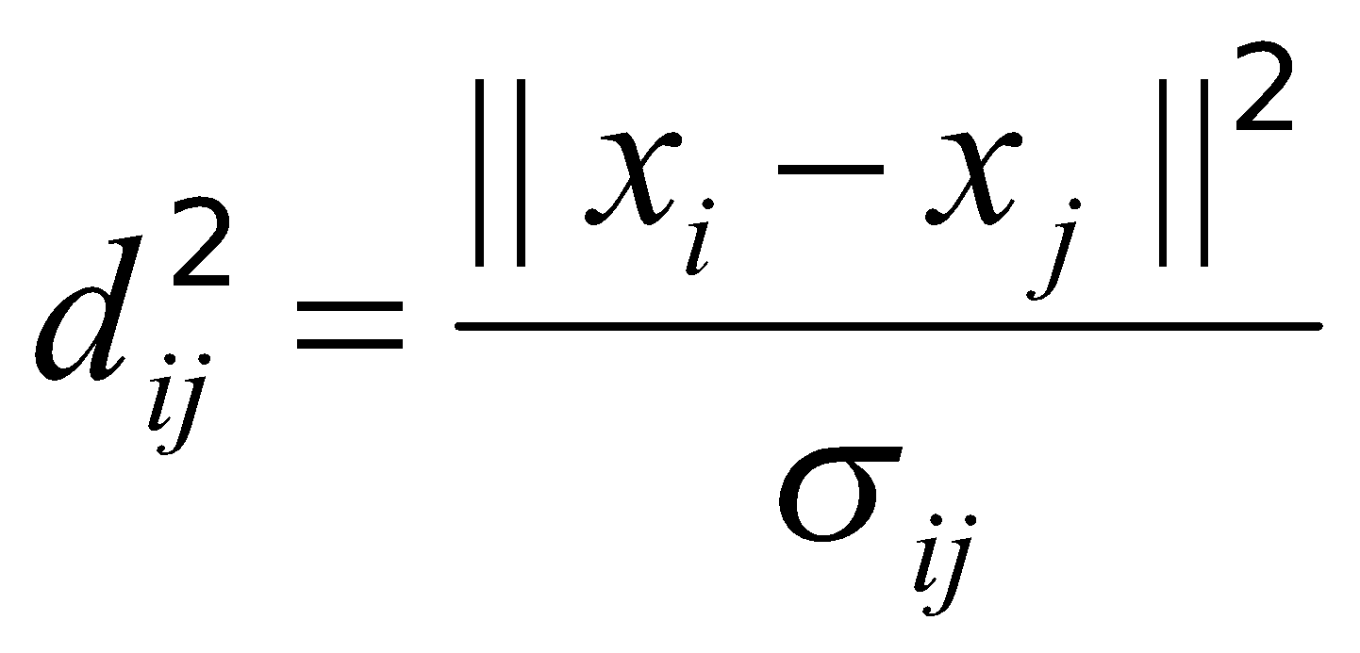
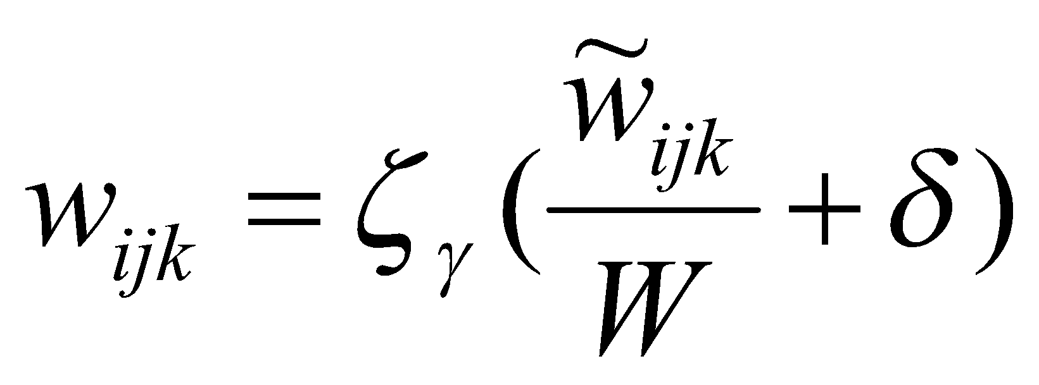
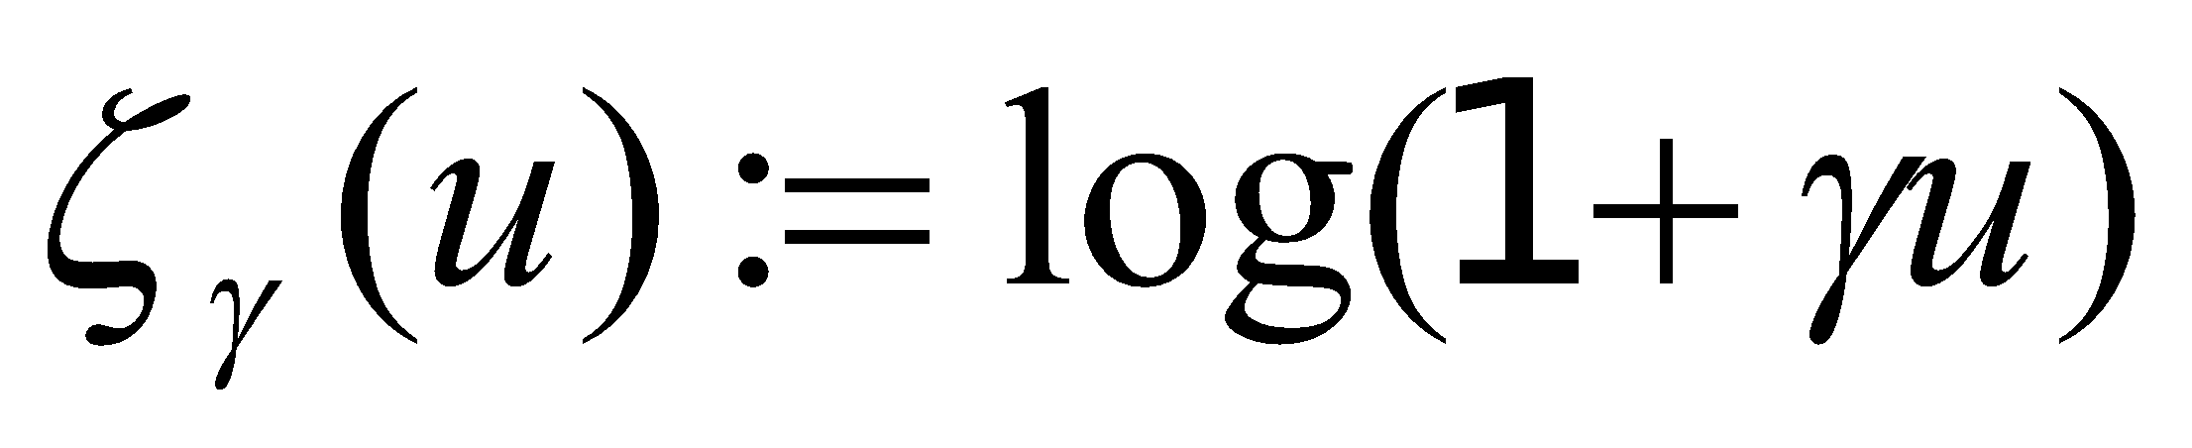
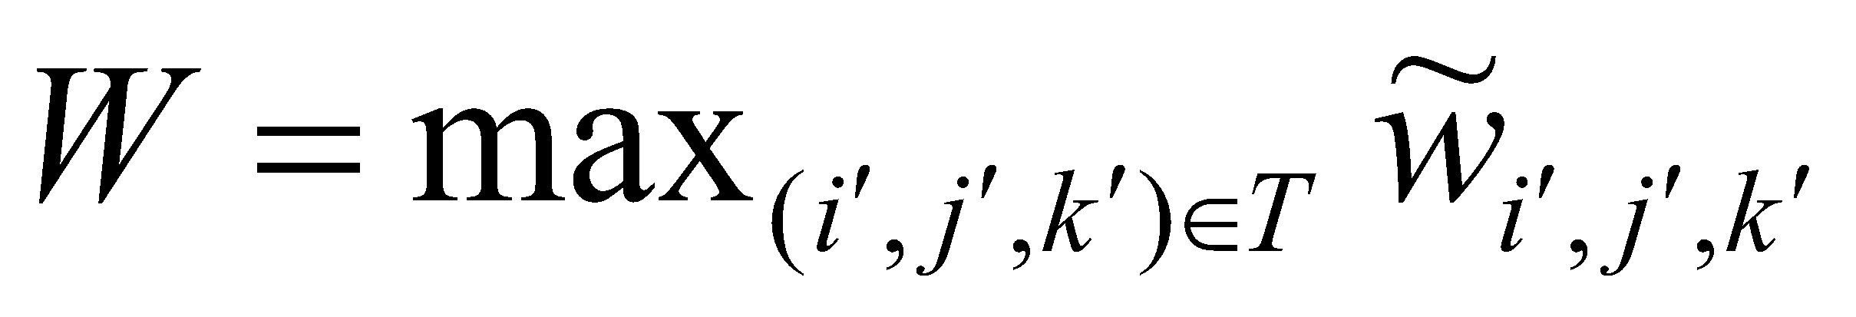
Weighing scheme for the triplet
,where

Slide 14
Initialization: initialize Y using PCA

Slide 15
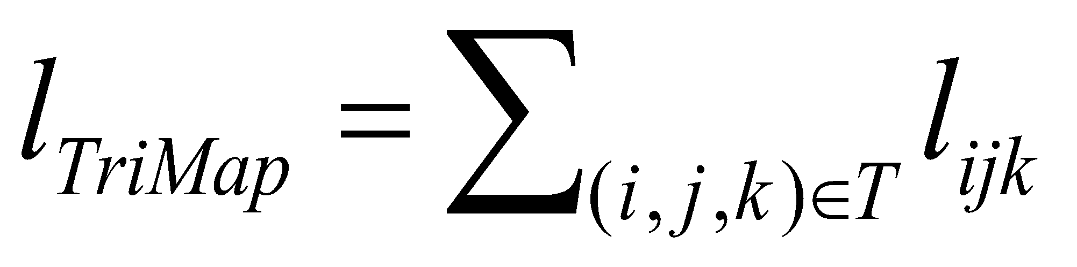
Define the final loss as:

Slide 16
Conclusion
The TriMap method:
Dimensionality reduction method based on triplet embedding
Fast and efficient method
Focuses on preserving the global data structure while embedding
Initialized with the low dimensional PCA embedding
Provides a much better global view of the data than
t-SNE, LargeVis and UMAP

Slide 17
Comparison of methods
We will now present individual methods on different data sets

Slide 18
Datasets
THE 20 NEWS GROUP
FASHION MNIST
MNIST
CIFAR-1O

Slide 19
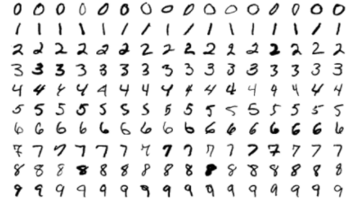
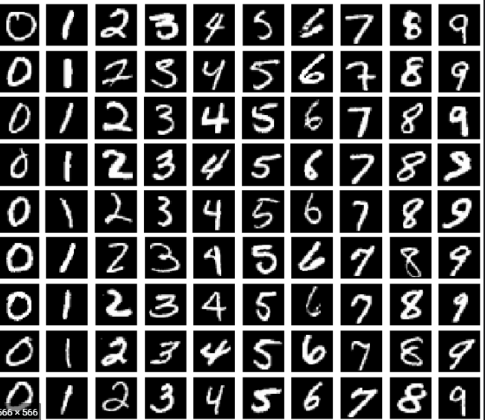
Comparison for the MNIST dataset

Slide 20
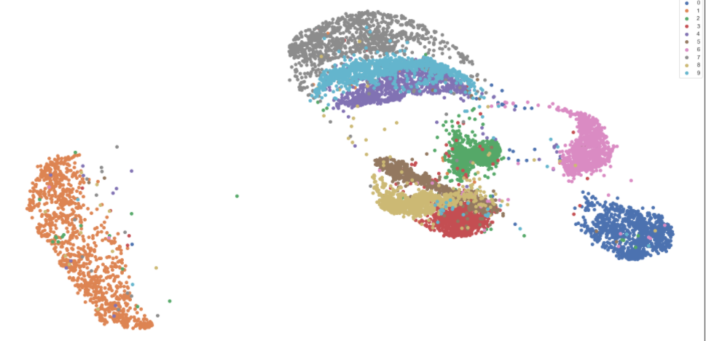
TriMap
Global Score: 0.93
Time: 33.23 s
Average distance inside/outside class ratio: 0.25

Slide 21
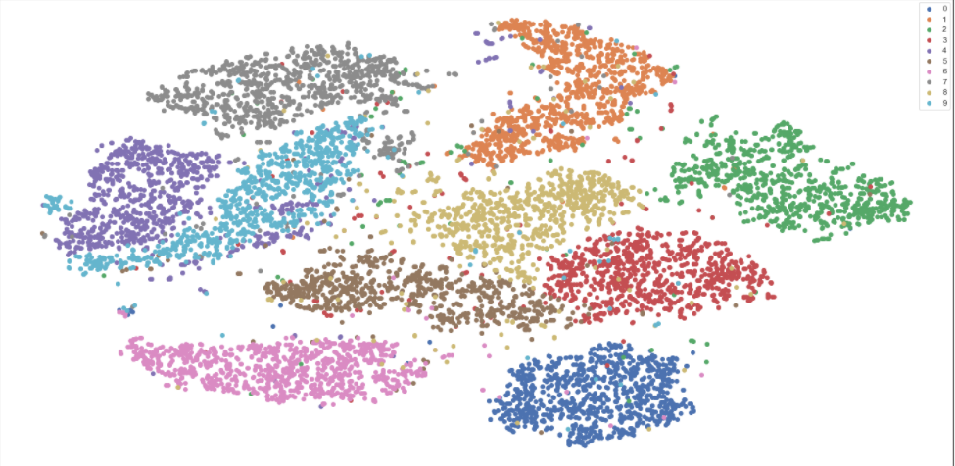
t-SNE
Time: 45.51 s
Average distance inside/outside class ratio: 0.34

Slide 22
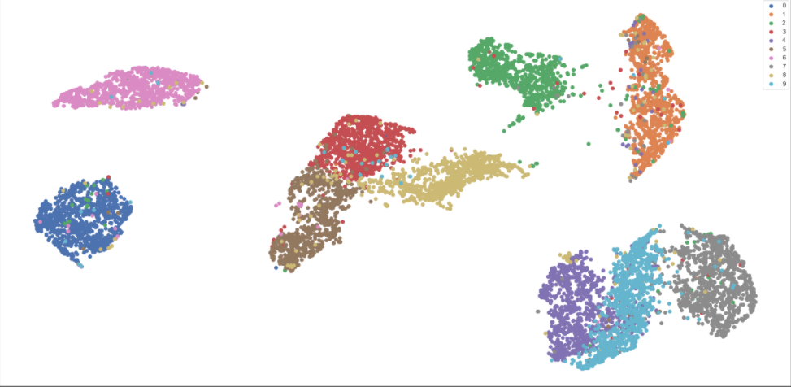
UMAP
Time: 31.98 s
Average distance inside/outside class ratio: 0.23

Slide 23
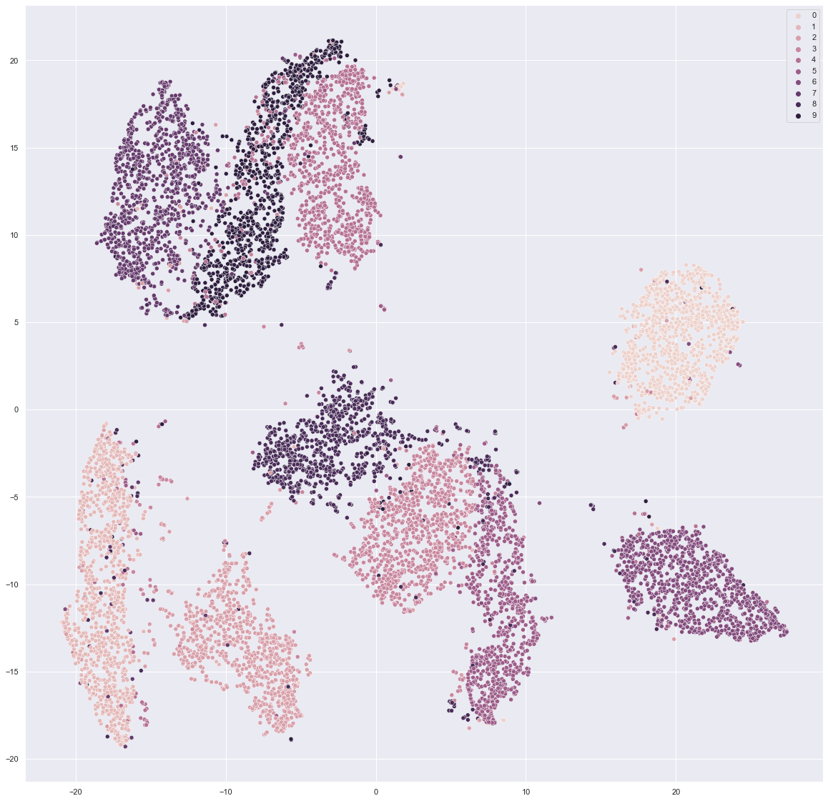
LargeVis
Time: 425.17 s
Average distance inside/outside class ratio: 0.27

Slide 24
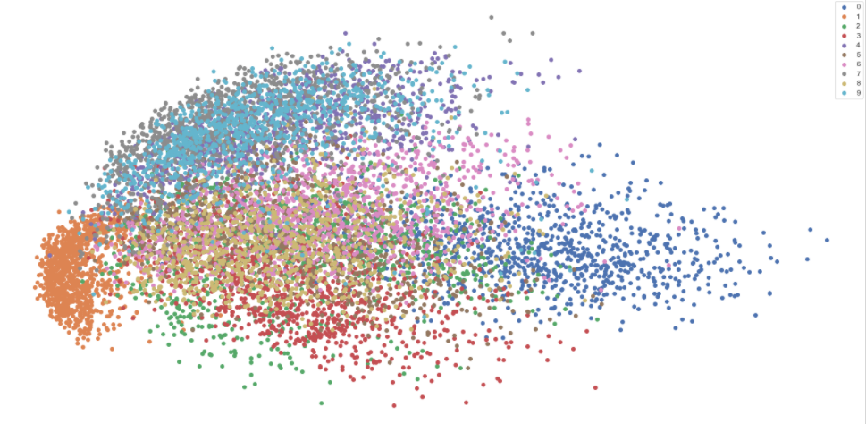
PCA
Time: 0.18
Average distance inside/outside class ratio: 0.57

Slide 25
Comparison for the MNIST dataset
Method | TriMap | t-SNE | UMAP | LargeVis | PCA
Time (s) | 33.23 | 45.51 | 31.98 | 425.17 | 0.18
Average distance inside/outside class ratio | 0.25 | 0.34 | 0.23 | 0.27 | 0.57

Slide 26
Comparison for the 20 News Group dataset

Slide 27
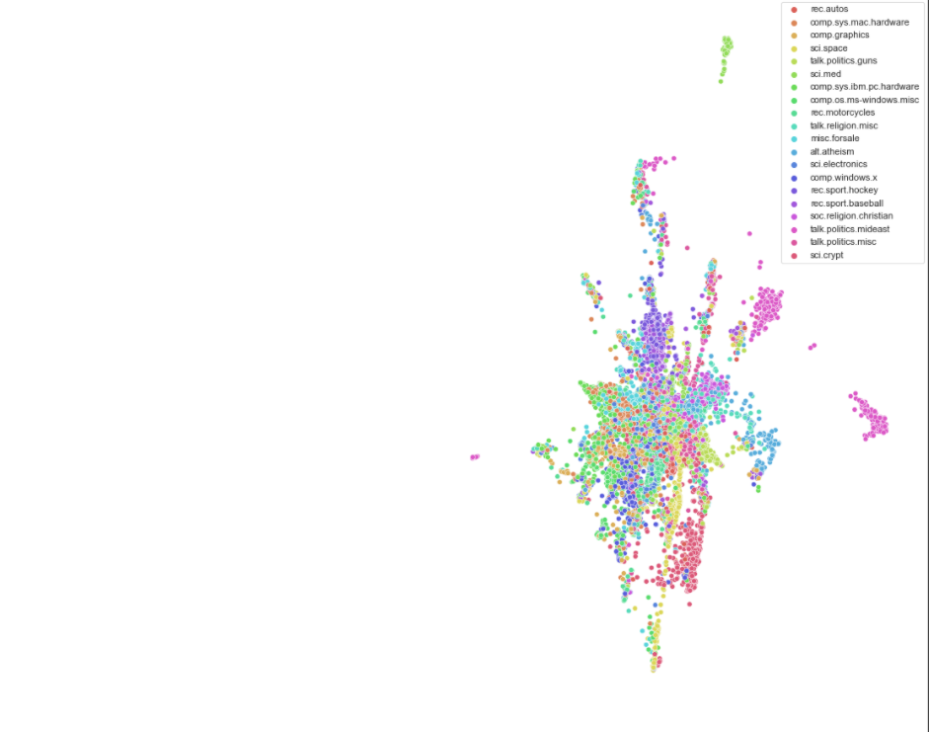
TriMap
Global Score: 0.99
Time: 38.09 s
Average distance inside/outside class ratio: 0.67

Slide 28
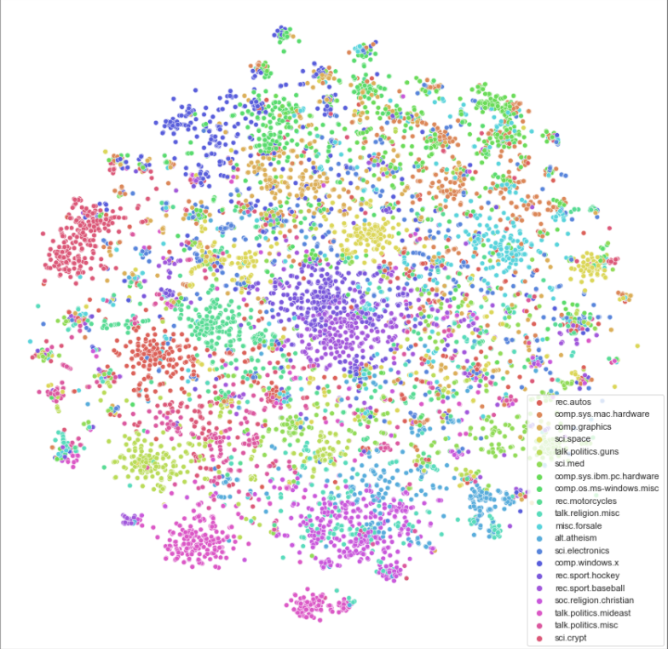
t-SNE
Time: 57.50 s
Average distance inside/outside class ratio: 0.64

Slide 29
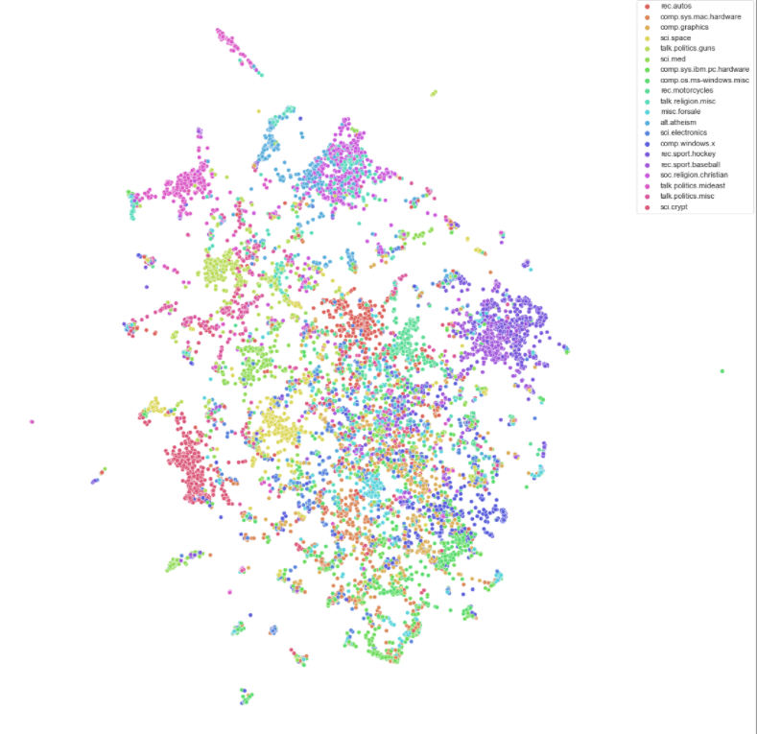
UMAP
Time: 64.97 s
Average distance inside/outside class ratio: 0.63

Slide 30
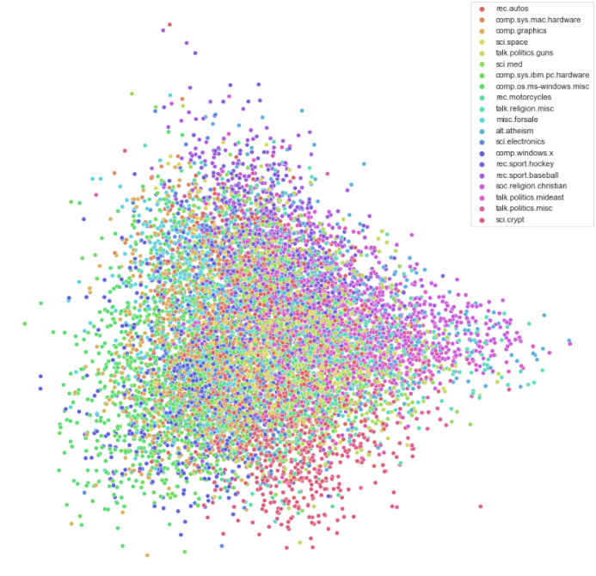
PCA
Time: 1.08 s
Average distance inside/outside class ratio: 0.74

Slide 31
Comparison for the 20 News Group dataset
Method | TriMap | t-SNE | UMAP | PCA
Time (s) | 38.09 | 57.50 | 64.97 | 1.08
Average distance inside/outside class ratio | 0.67 | 0.64 | 0.63 | 0.74

Slide 32
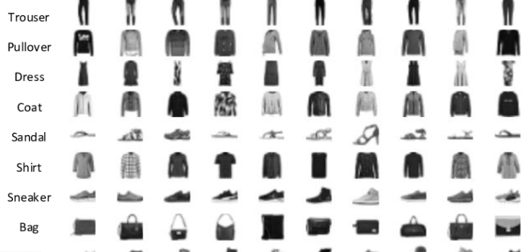
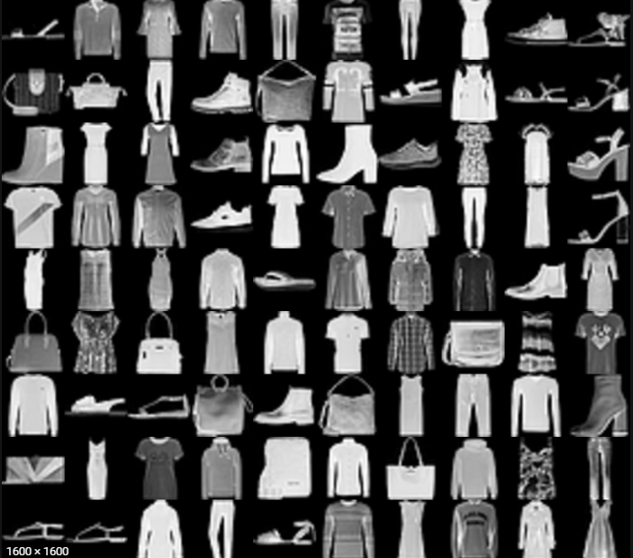
Comparison for the Fashion-MNIST dataset

Slide 33
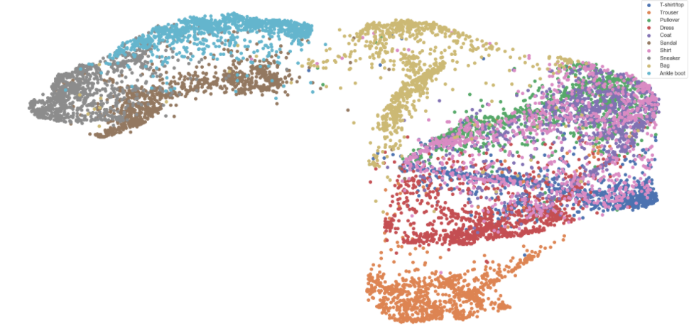
TriMap
Global Score: 0.88
Time: 49.84 s
Average distance inside/outside class ratio: 0.31

Slide 34
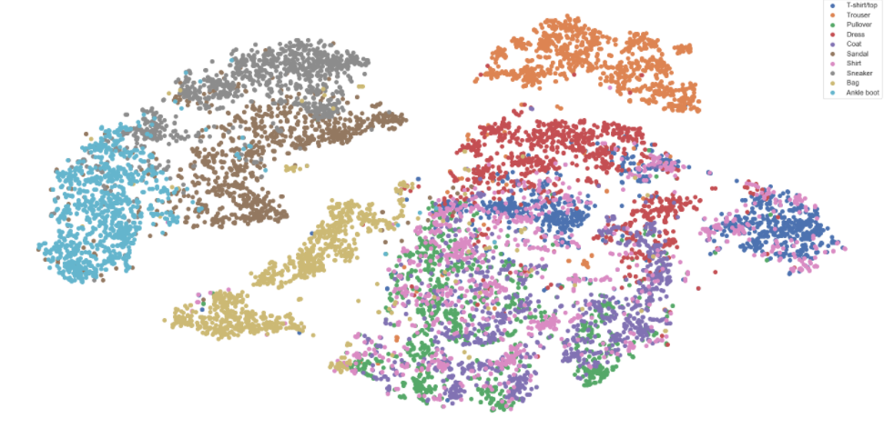
t-SNE
Time: 52.99 s
Average distance inside/outside class ratio: 0.39

Slide 35
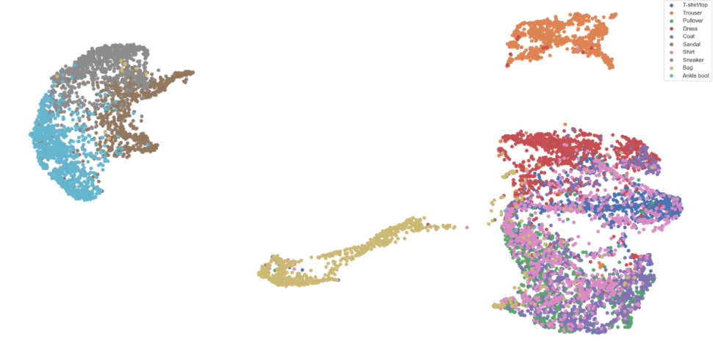
UMAP
Time: 95.78 s
Average distance inside/outside class ratio: 0.25

Slide 36
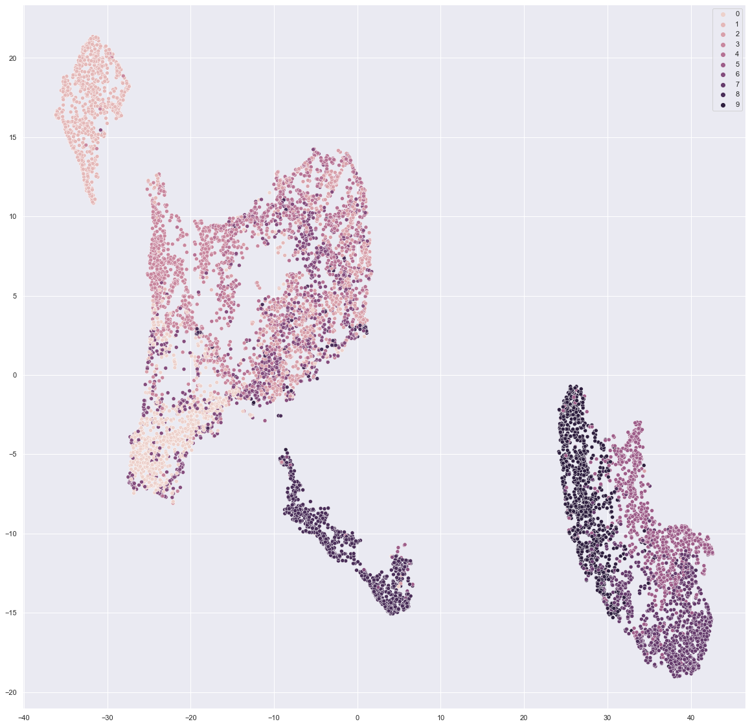
LargeVis
Time: 461.62 s
Average distance inside/outside class ratio: 0.23

Slide 37
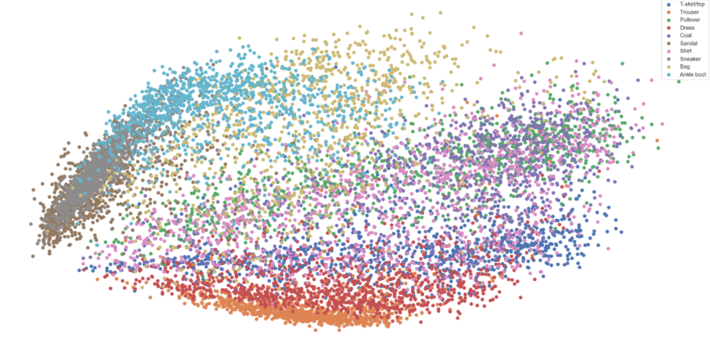
PCA
Time: 0.47 s
Average distance inside/outside class ratio: 0.51

Slide 38
Comparison for the Fashion-MNIST dataset
Method | TriMap | t-SNE | UMAP | LargeVis | PCA
Time (s) | 49.84 | 52.99 | 95.78 | 461.62 | 0.47
Average distance inside/outside class ratio | 0.31 | 0.39 | 0.25 | 0.23 | 0.51

Slide 39
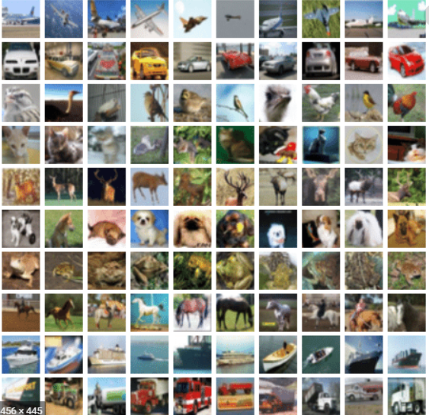
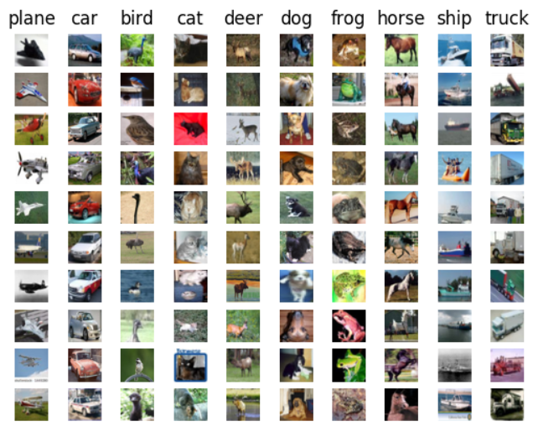
Comparison for CIFAR-10 dataset

Slide 40
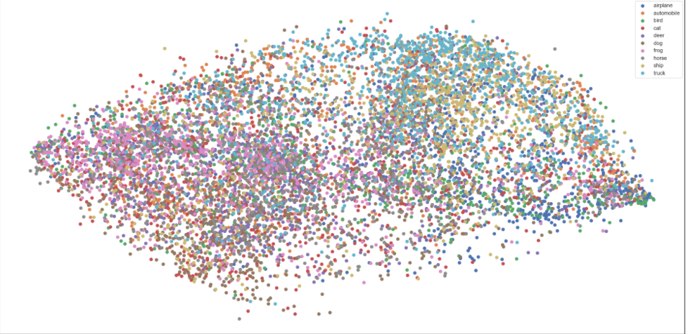
TriMap
Global Score: 0.96
Time: 45.10 s
Average distance inside/outside class ratio: 0.89

Slide 41
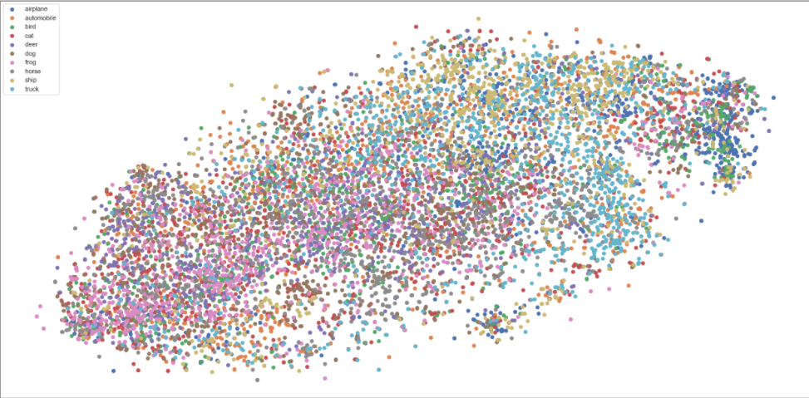
t-SNE
Time: 65.03 s
Average distance inside/outside class ratio: 0.89

Slide 42
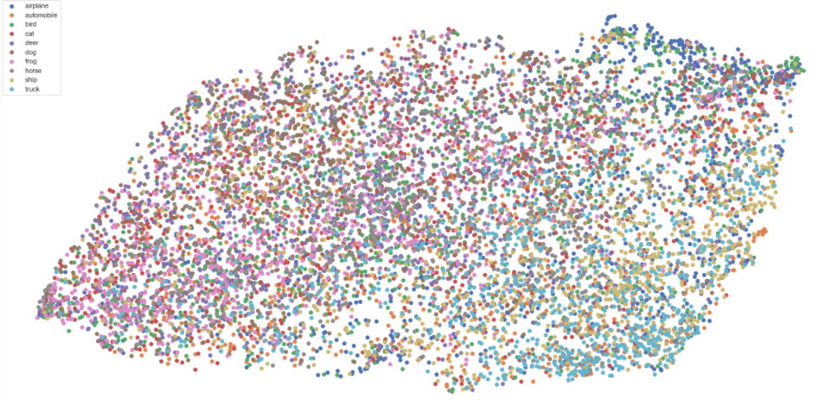
UMAP
Time: 74.83 s
Average distance inside/outside class ratio: 0.89

Slide 43
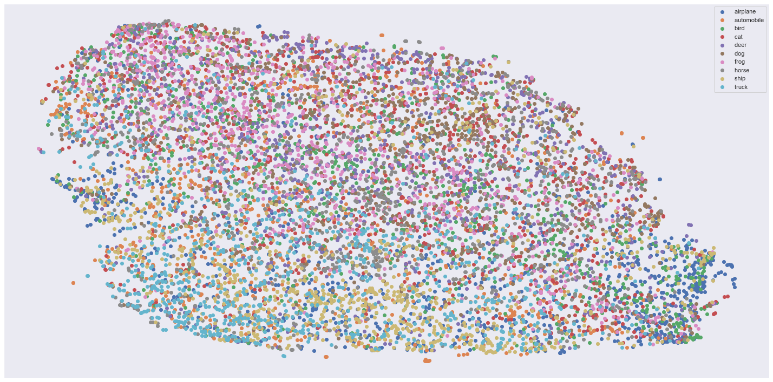
LargeVis
Time: 528.48 s
Average distance inside/outside class ratio: 0.88

Slide 44
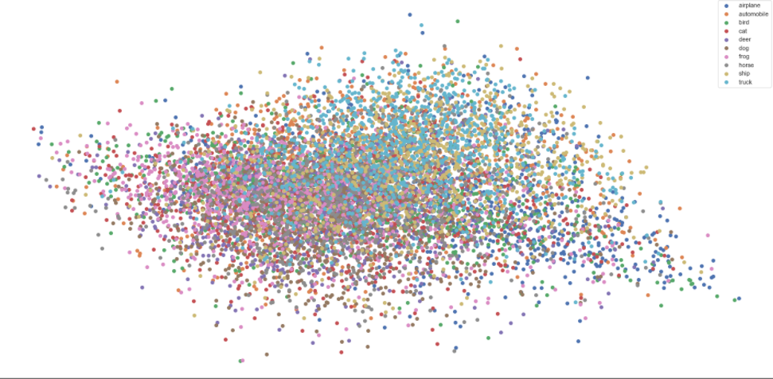
PCA
Time: 3.36 s
Average distance inside/outside class ratio: 0.91

Slide 45
Comparison for the CIFAR-10 dataset
Method | TriMap | t-SNE | UMAP | LargeVis | PCA
Time (s) | 45.10 | 65.03 | 74.83 | 528.48 | 3.36
Average distance inside/outside class ratio | 0.89 | 0.89 | 0.89 | 0.89 | 0.91

Slide 46
Comparison for Covertype dataset

Slide 47
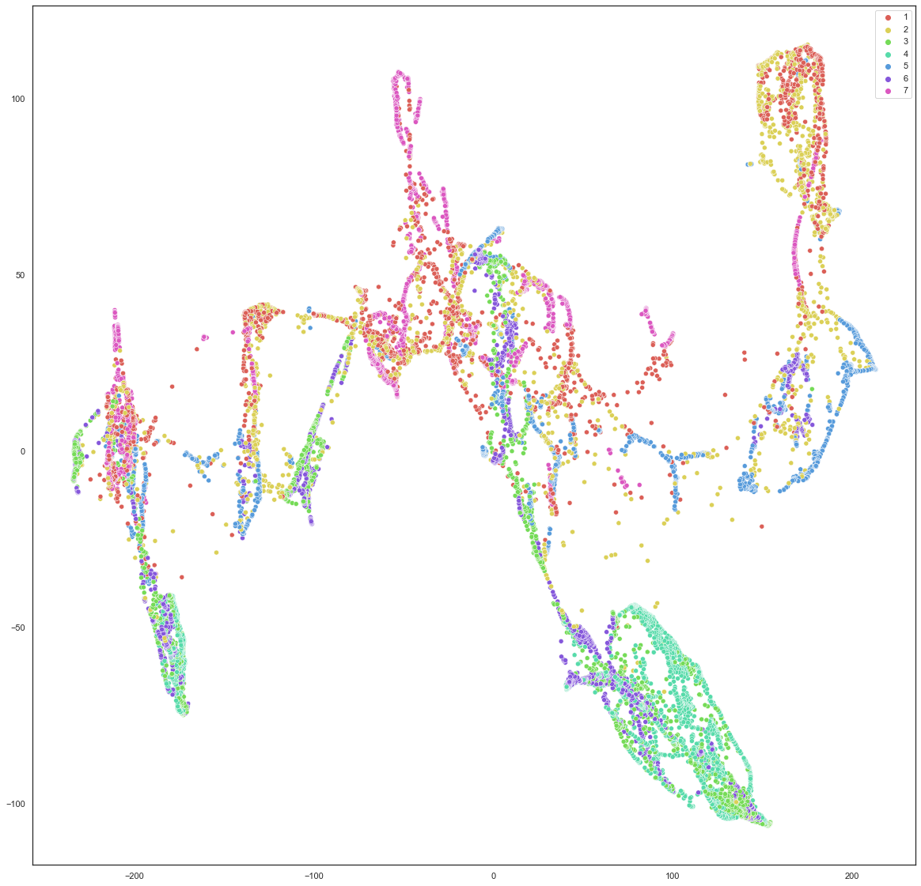
TriMap
Global Score: 0.23
Time: 65.4
Average distance inside/outside class ratio: 0.90

Slide 48
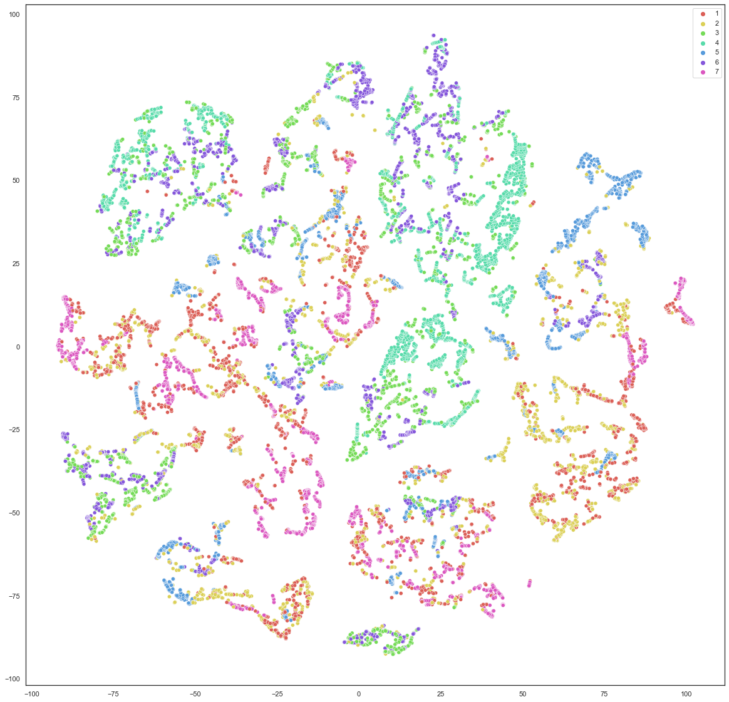
t-SNE
Time: 65.19 s
Average distance inside/outside class ratio: 0.89

Slide 49
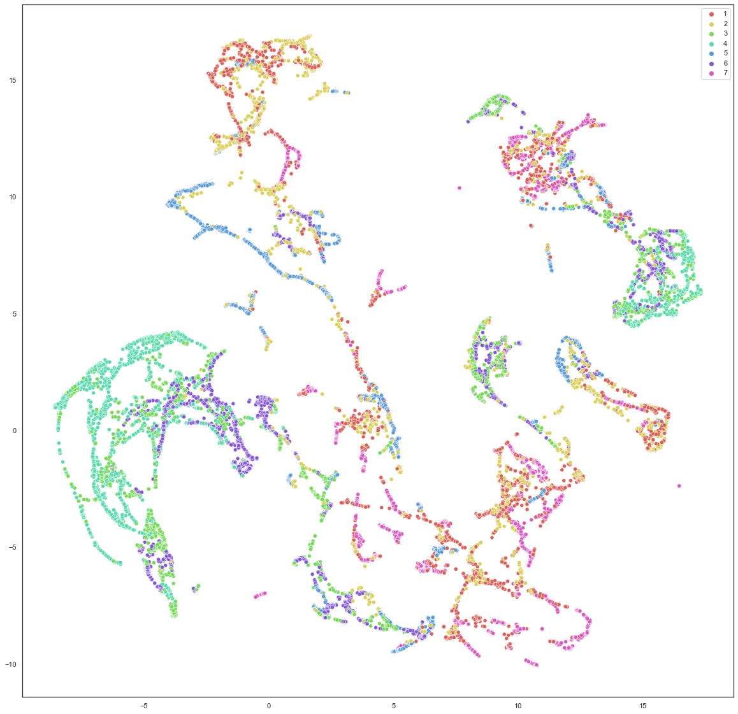
UMAP
Time: 29.88
Average distance inside/outside class ratio: 0.88

Slide 50
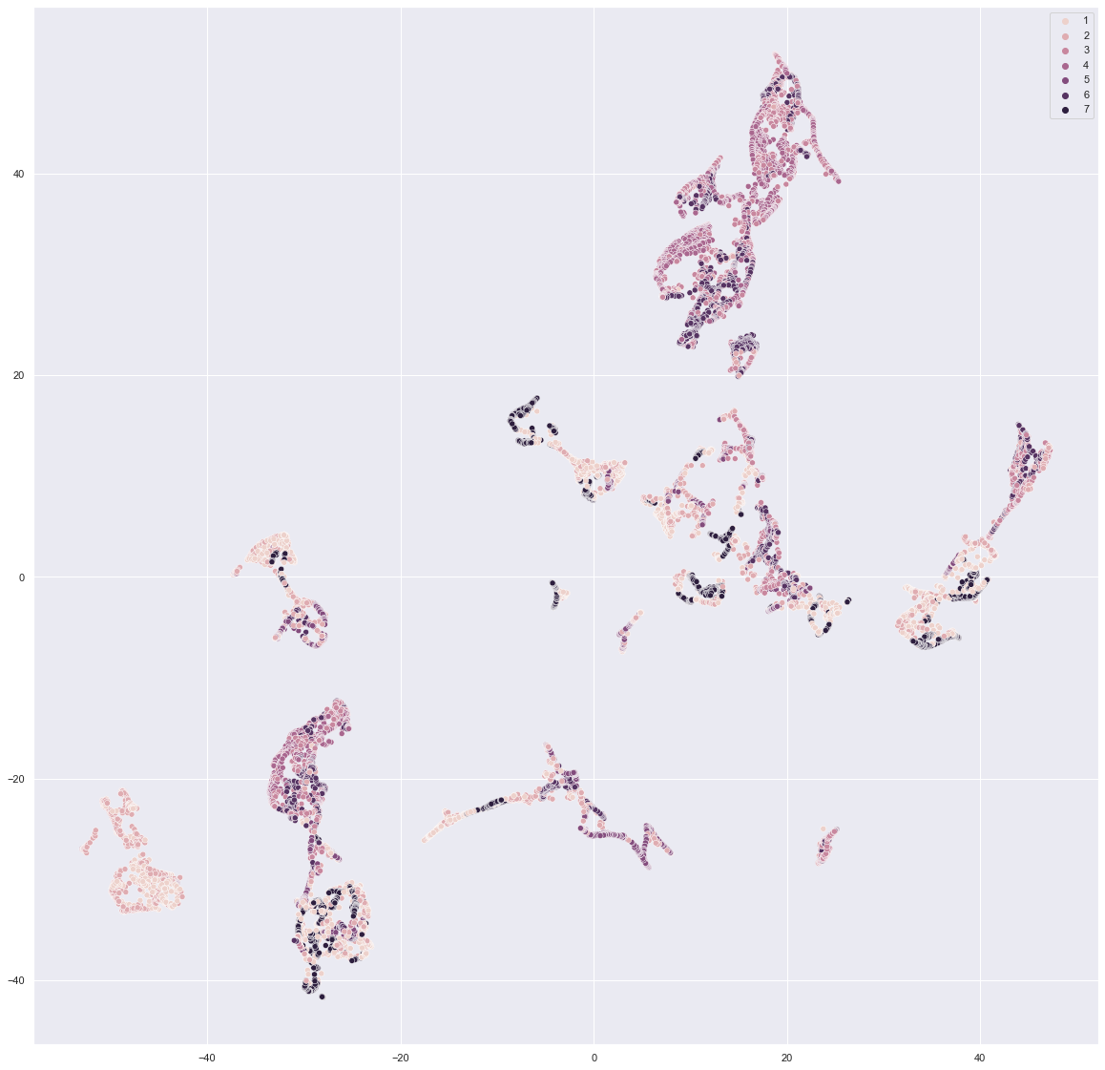
LargeVis
Time: 439.68
Average distance inside/outside class ratio: 0.83

Slide 51
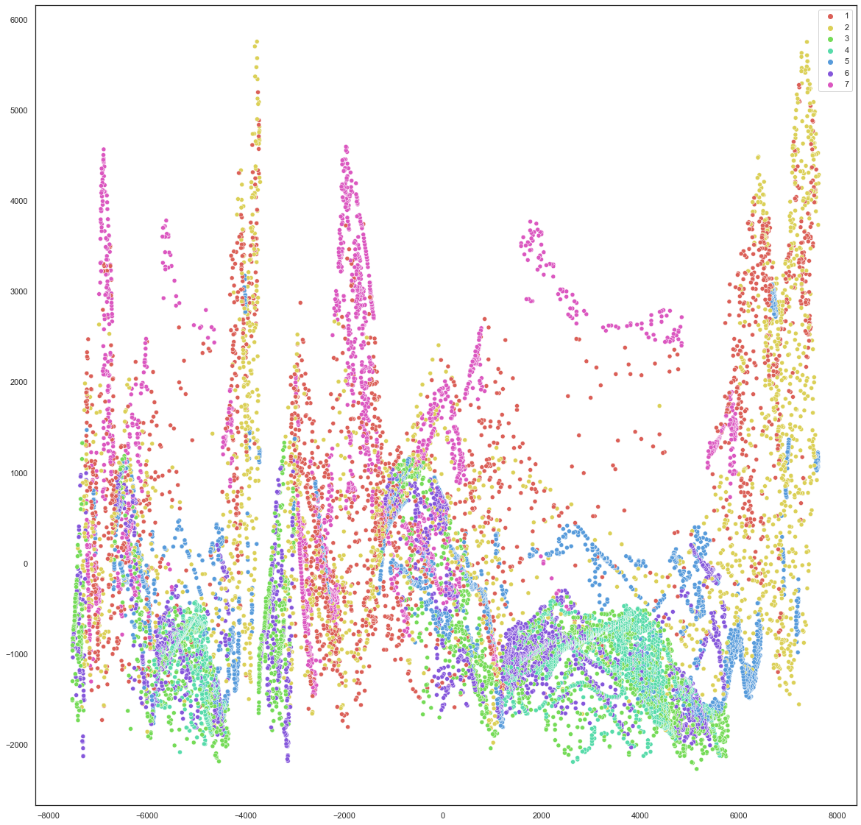
PCA
Time: 1.31
Average distance inside/outside class ratio: 0.89

Slide 52
Comparison for the Covertype dataset
Method | TriMap | t-SNE | UMAP | LargeVis | PCA
Time (s) | 65.4 | 65.19 | 29.88 | 439.68 | 1.31
Average distance inside/outside class ratio | 0.90 | 0.89 | 0.88 | 0.83 | 0.89

